Slide 1
Task-oriented interactions in Microsoft Teams with messaging extensions

Slide 2
Messaging extensions overview
Action commands
Creating action commands

Slide 3
Microsoft Teams Messaging Extensions

Slide 4
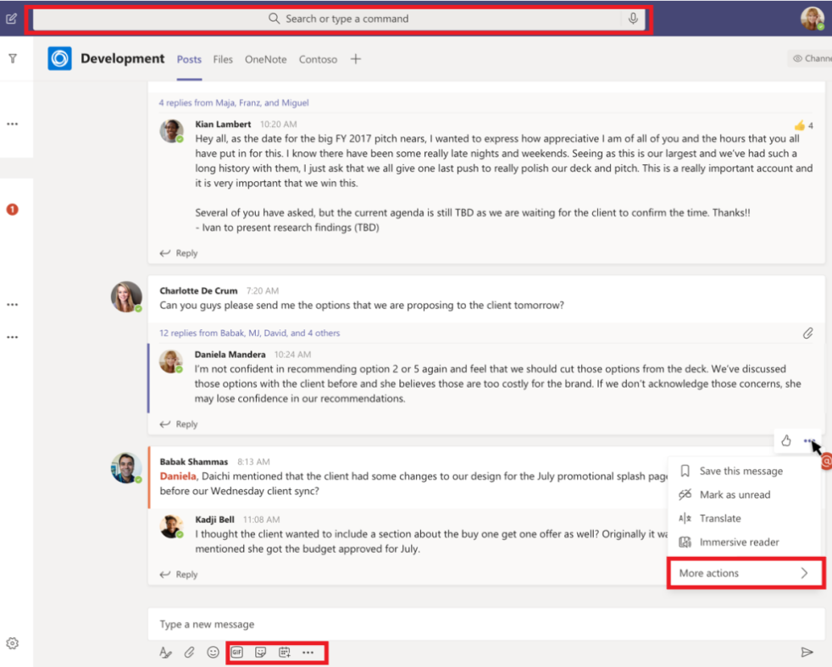
What are Microsoft Teams messaging extensions?
Enable users to interact with a web service through buttons and forms in the Microsoft Teams client
Invoke actions
Execute search queries
Expand URLs with additional detail

Slide 5
Messaging extension scenarios
Perform action in external systems & include results in conversation
Complete complex task involving multiple steps and share results

Slide 6
How they work
Can be invoked from one of the following locations in Microsoft Teams:
Command box
Compose message box
Message’s “More Actions” menu
Implemented as web services
Microsoft Teams communicates with the web service through the Bot Framework
Messaging extensions are registered as bots with the Bot Framework
Web service responds with task modules or richly formatted cards

Slide 7
Types of messaging extensions
Action commands
Present user with a task module to collection information and act on it
Optionally respond with another task module, plain text message or richly formatted adaptive card
Search commands
Enable user to search external system from the command box or compose message box

Slide 8
Developing action commands
Action commands can be triggered from the following locations:
Command box
Compose message box
Message’s context menu
When invoked, JSON payload sent to the registered web service
Web service responds with task module implemented with web interface or adaptive card

Slide 9
Register action command messaging extensions in the app manifest
"composeExtensions": [
{
"botId": "<REPLACE_WITH_MICROSOFT_APP_ID>",
"canUpdateConfiguration": false,
"commands": [
{
"id": "planetExpanderAction",
"type": "action",
"title": "Planet Expander",
"description": "Lookup the details of a planet.",
"context": [ "compose", "message"],
"parameters": [...],
"fetchTask": true
}
]
}]

Slide 10
How will the action command respond?
Decide how the message will be set back to the user
Insert message in the compose message box?
Respond directly to a conversation?
When responding directly to conversation, must also register the web service as a bot in the app manifest
If responding directly to conversation, can update / delete the message later via the bot

Slide 11
Create and send the task module when the action command is invoked
export class PlanetBot extends TeamsActivityHandler { // handle the Activity type = “composeExtension/fetchTask”
protected handleTeamsMessagingExtensionFetchTask( context: TurnContext, action: MessagingExtensionAction ): Promise<MessagingExtensionActionResponse> {
const adaptiveCardSource: any = require("./planetSelectorCard.json");
const adaptiveCard = CardFactory.adaptiveCard(adaptiveCardSource);
let response: MessagingExtensionActionResponse = <MessagingExtensionActionResponse>{
task: {
type: "continue",
value: { card: adaptiveCard, title: 'Planet Selector’, height: 150, width: 500 }
}};
return Promise.resolve(response);
}}

Slide 12
Handling the messaging extension task module submission
export class PlanetBot extends TeamsActivityHandler {
// handle the Activity type = “composeExtension/submitAction”
protected handleTeamsMessagingExtensionSubmitAction(
context: TurnContext,
action: MessagingExtensionAction): Promise<MessagingExtensionActionResponse> {
switch (action.commandId) {
case 'planetExpanderAction':
const adaptiveCard = this.getPlanetDetailCard(action.data.planetSelector);
return Promise.resolve(<MessagingExtensionActionResponse>{
composeExtension: {
type: "result", attachmentLayout: "list", attachments: [adaptiveCard] }
});
break;
default:
throw new Error('NotImplemented');
} } }

Slide 13
DEMO
Create action command messaging extensions

Slide 14
Search commands
Creating search commands

Slide 15
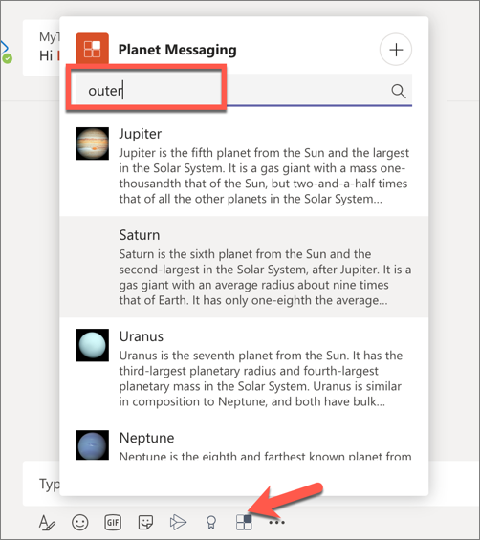
What are search commands?
Action commands enable users to search an external system for information
Search query is sent from Microsoft Teams to your web service
Your web service responds with a list or grid of results
When a user selects a result, it is added to the compose message box as a card or text

Slide 16
Register search command messaging extensions in the app manifest
"composeExtensions": [
{
"botId": "<REPLACE_WITH_MICROSOFT_APP_ID>",
"canUpdateConfiguration": false,
"commands": [
{
"id": "planetExpanderSearch",
"type": ”search",
"title": "Planet Lookup",
"description": ”Search for a planet.",
"context": [ "compose"],
"parameters": [{ title: “Planet”, name: ”searchKeyword”,
description: ”Enter ‘inner’, ‘outer’, or the name of a planet” }],
}
]
}]

Slide 17
Responding to search command queries
export class PlanetBot extends TeamsActivityHandler {
protected handleTeamsMessagingExtensionQuery(context, query) : Promise<MessagingExtensionResponse> {
// get the search query
let searchQuery = query.parameters[0].value.trim().toLowerCase();
// execute search logic
let queryResults: string[] = ...;
// get results as cards
let cards: MessagingExtensionAttachment[] = [];
queryResults.forEach((planet) => {
cards.push(this.getPlanetResultCard(planet));
});
let response: MessagingExtensionResponse = <MessagingExtensionResponse>{
composeExtension: { type: "result", attachmentLayout: "list", attachments: cards } };
return Promise.resolve(response);
} }

Slide 18
DEMO
Create search command messaging extensions

Slide 19
Search commands
Creating search commands

Slide 20
What are search commands?
Action commands enable users to search an external system for information
Search query is sent from Microsoft Teams to your web service
Your web service responds with a list or grid of results
When a user selects a result, it is added to the compose message box as a card or text

Slide 21
Register search command messaging extensions in the app manifest
"composeExtensions": [
{
"botId": "<REPLACE_WITH_MICROSOFT_APP_ID>",
"canUpdateConfiguration": false,
"commands": [
{
"id": "planetExpanderSearch",
"type": ”search",
"title": "Planet Lookup",
"description": ”Search for a planet.",
"context": [ "compose"],
"parameters": [{ title: “Planet”, name: ”searchKeyword”,
description: ”Enter ‘inner’, ‘outer’, or the name of a planet” }],
}
]
}]

Slide 22
Responding to search command queries
export class PlanetBot extends TeamsActivityHandler {
protected handleTeamsMessagingExtensionQuery(context, query) : Promise<MessagingExtensionResponse> {
// get the search query
let searchQuery = query.parameters[0].value.trim().toLowerCase();
// execute search logic
let queryResults: string[] = ...;
// get results as cards
let cards: MessagingExtensionAttachment[] = [];
queryResults.forEach((planet) => {
cards.push(this.getPlanetResultCard(planet));
});
let response: MessagingExtensionResponse = <MessagingExtensionResponse>{
composeExtension: { type: "result", attachmentLayout: "list", attachments: cards } };
return Promise.resolve(response);
} }

Slide 23
DEMO
Create search command messaging extensions

